Slide 1
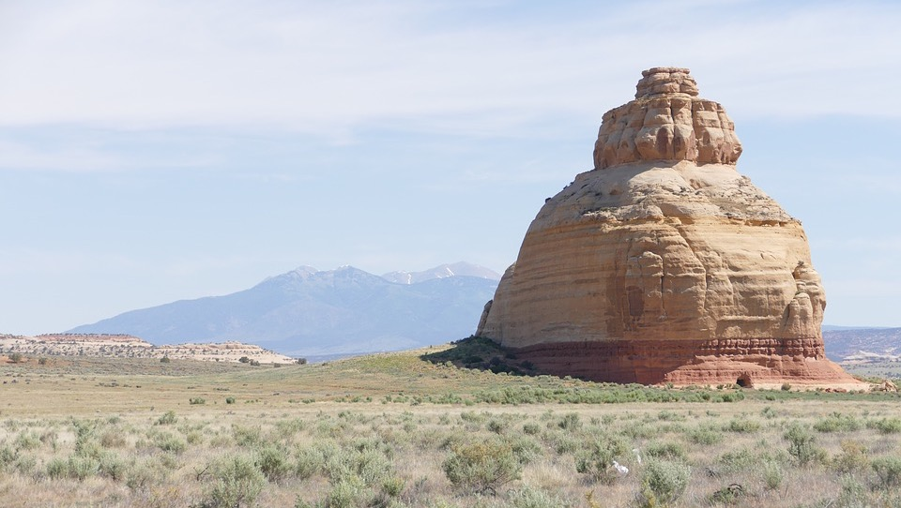
Ever try to Geocode a Craton?
Building a geological feature geocoding engine
FOSS4G NA – St Louis – May 14, 2018
Corey A Harper – Elsevier Labs
@chrpr – c.harper@elsevier.com

Slide 2
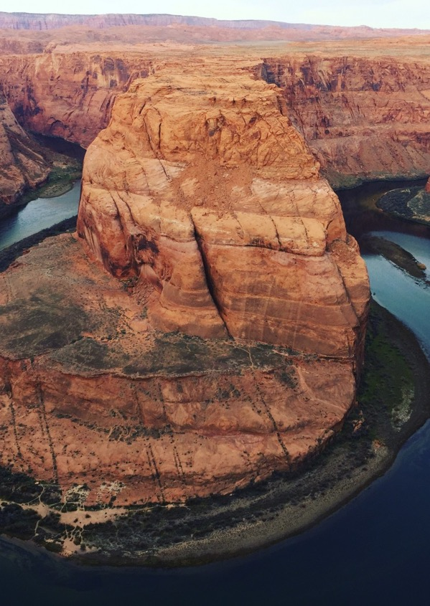
Agenda
Geofacets Background
Problem Statement
Previous work
Data and proposed solution
Tooling and code
Results
Future work

Slide 3
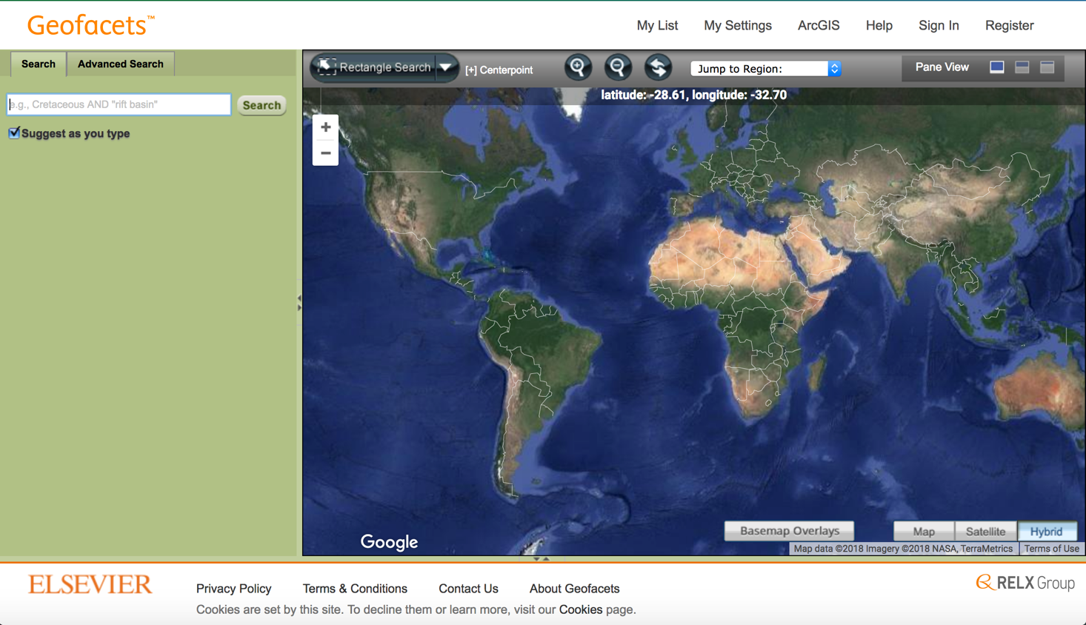

Slide 4

Geofacets Demo

Slide 5
How does this work?
Currently manual processing
Map inset geolocation at “Area of Interest” level
Tables and figures geolocated with maps from same article
Hard to scale this to public data sources
Can’t geo-reference non-cartographic resources

Slide 6
Geocoding (vs Georeferencing)
Geonames
Two Fishes (no more demo?)
Who’s on First “Spelu
Google Maps API
Yahoo Maps API
Other sources of Geo Data
Library of Congress Subject Headings
Getty Thesaurus of Geographic Names

Slide 7
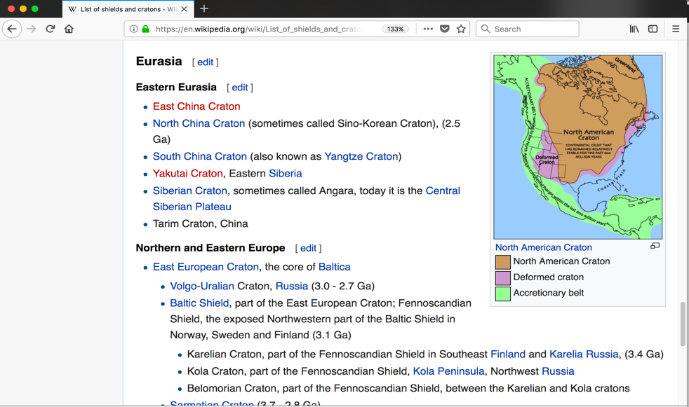
Cratons and Shields

Slide 8
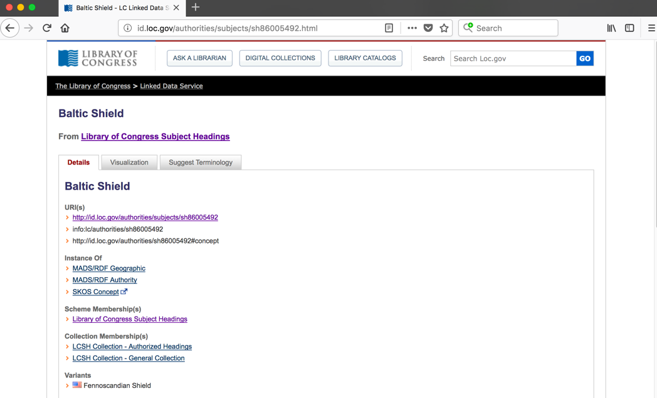
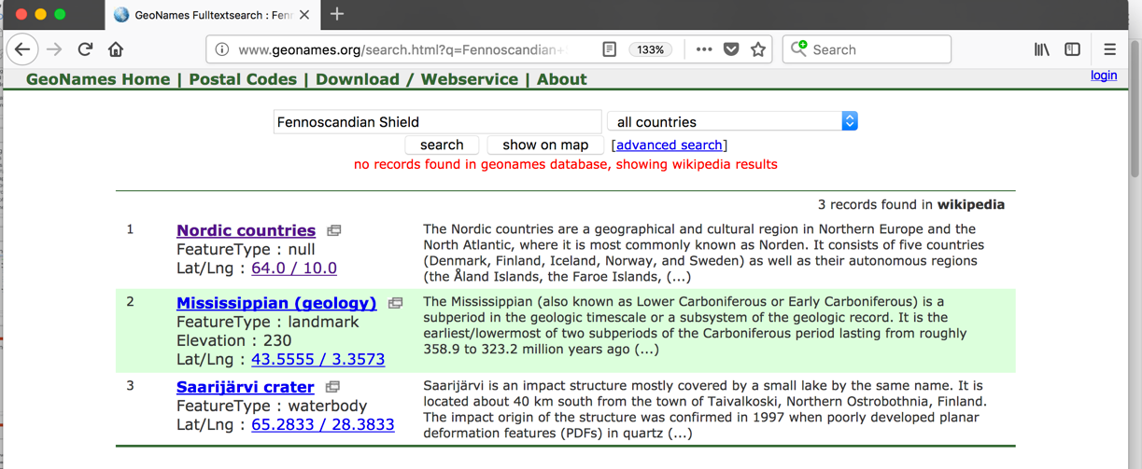
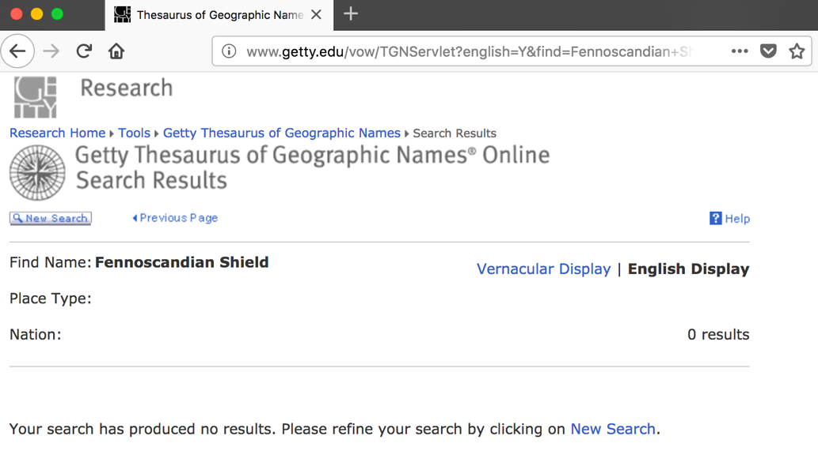
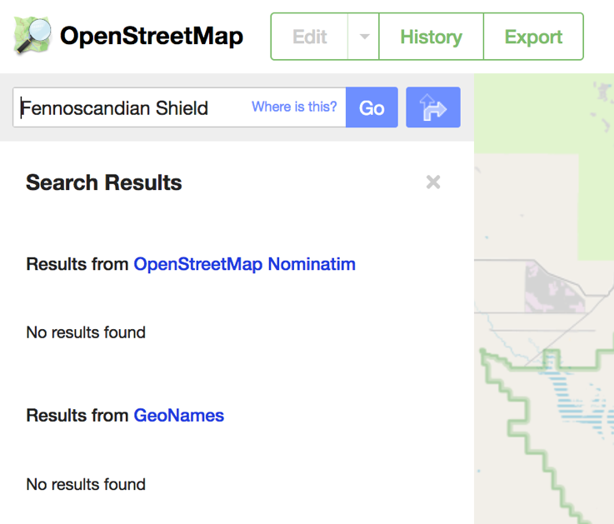
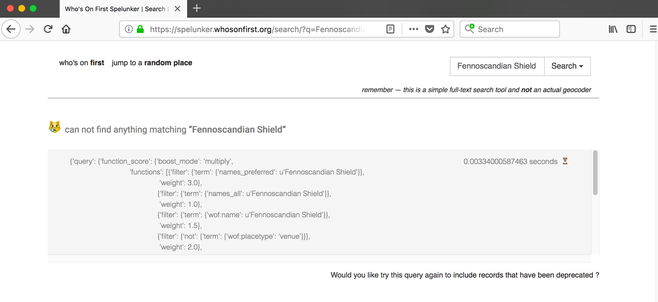
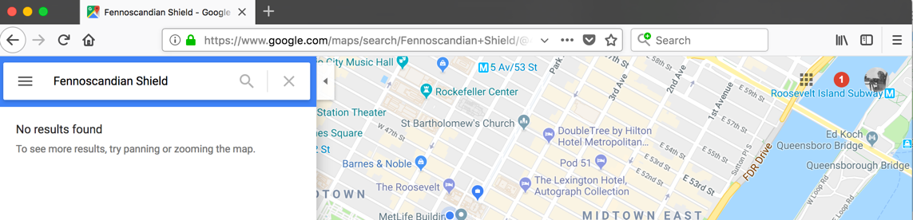
Fennoscandian Shield

Slide 9
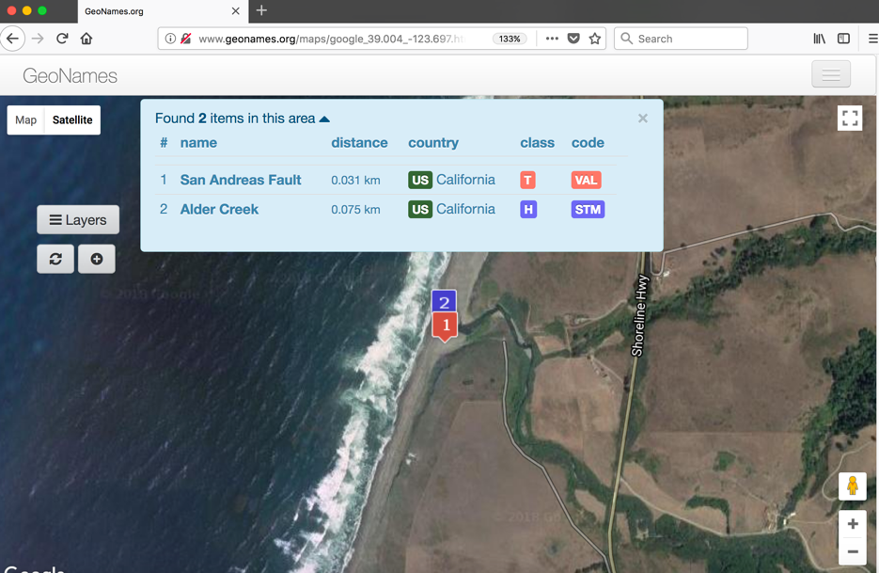
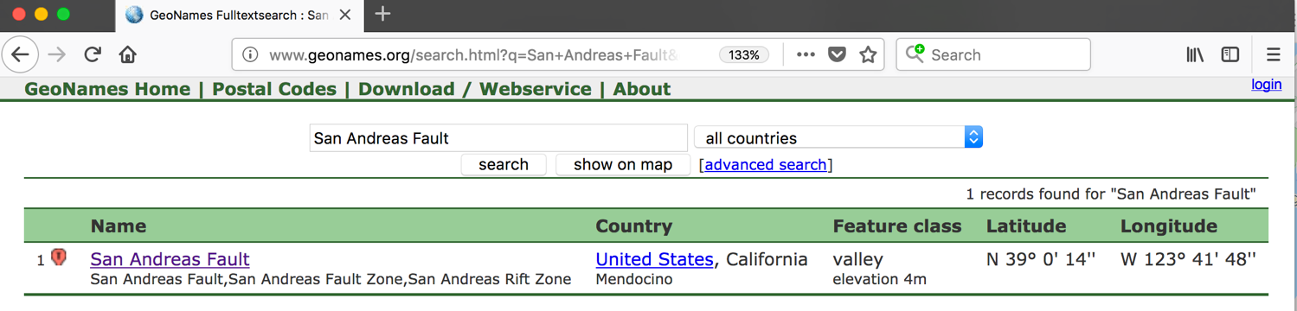
San Andreas Fault

Slide 10
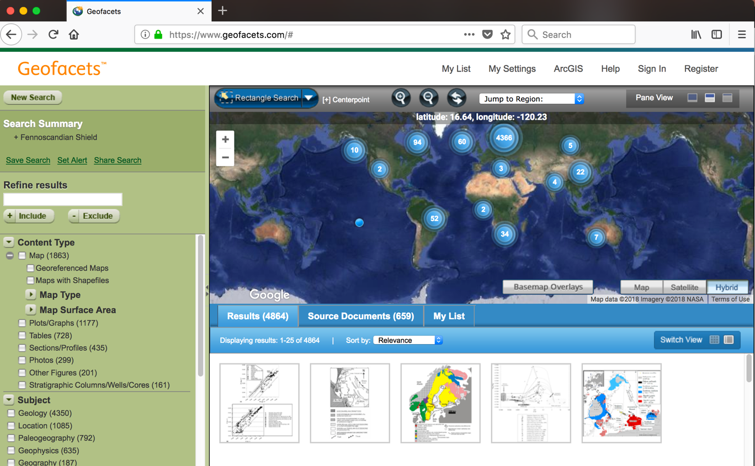
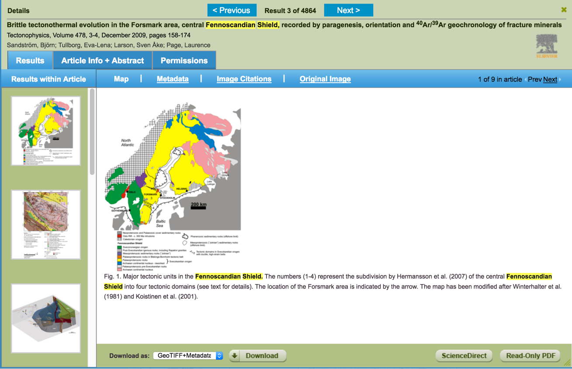

Slide 11
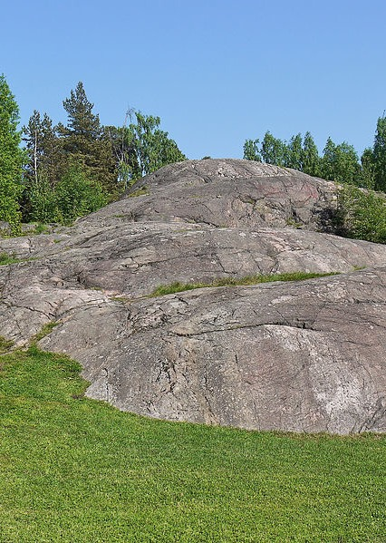
A Research Proposal
Roll our own geolocation engine
Based on Geofacets data:
Polygons for Areas of Interest
Captions of map insets
Additional article metadata?

Slide 12
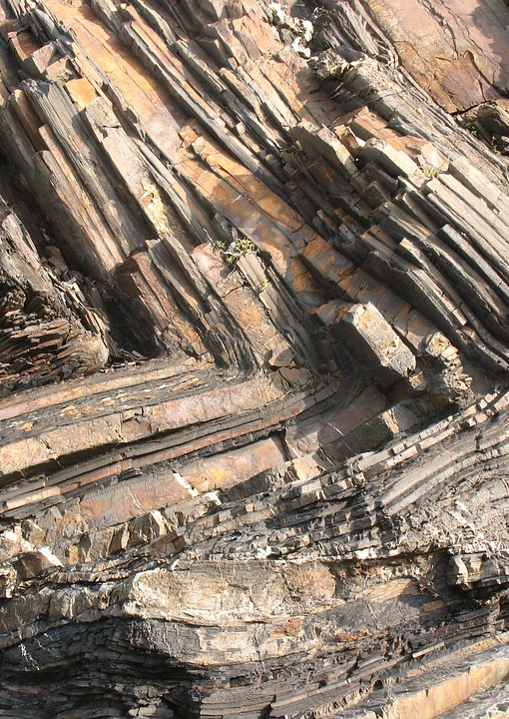
Open Source Tools
Geohash Algorithm
MySQL
Elastic Search
Google Maps API
Python
Pandas
Shapely
Geohash
SpaCy
GeoPy
Django

Slide 13
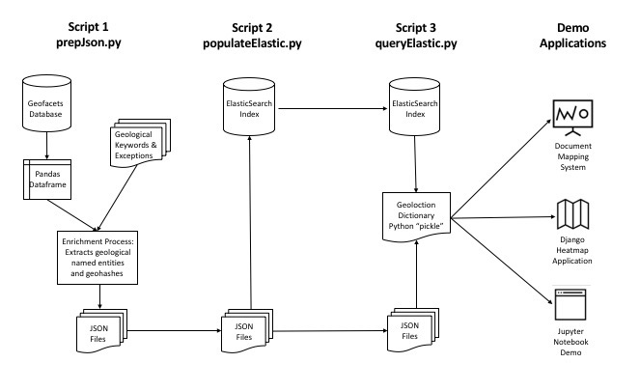
System Architecture

Slide 14
Starting Data
Lat / Long Bounding Boxes (Coordinate System Normalized)
Lat / Long Center Points
Caption Text
Other article metadata
Basin Names

Slide 15
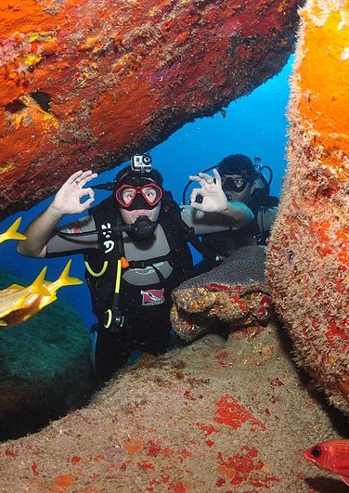
Code Dive!!
Panda’s Lambdas
For Named Entities
For GeoHashes
For GeoNeighbors
Some Data Cleanup
Load to Elastic
Query Elastic
Dump to Django

Slide 16
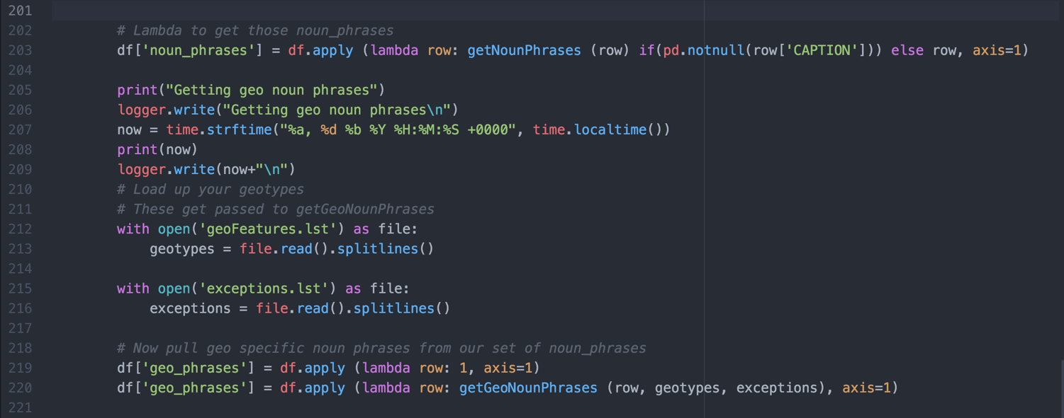
SpaCy Lambdas for Noun Phrases

Slide 17
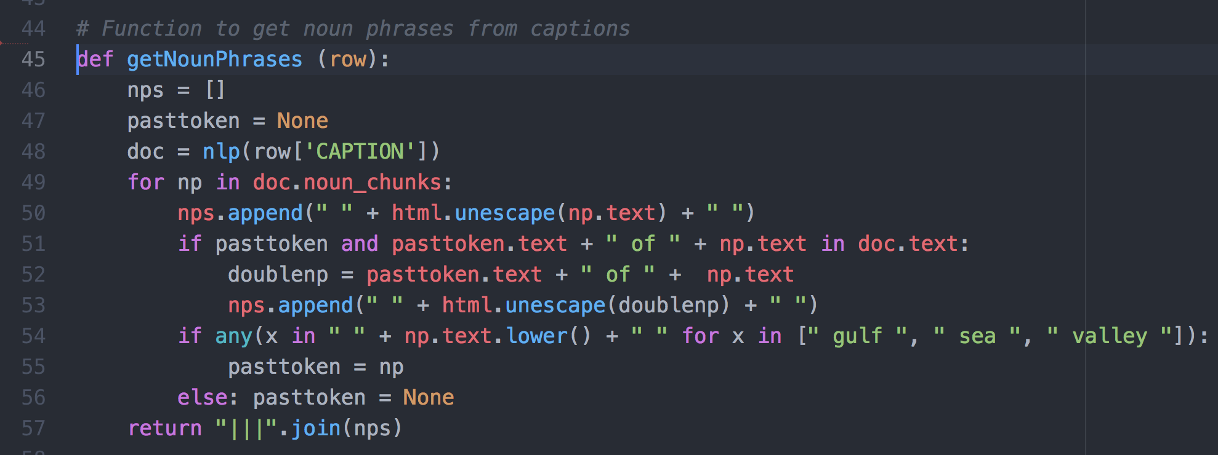
Using SpaCy’s Noun Chunker

Slide 18
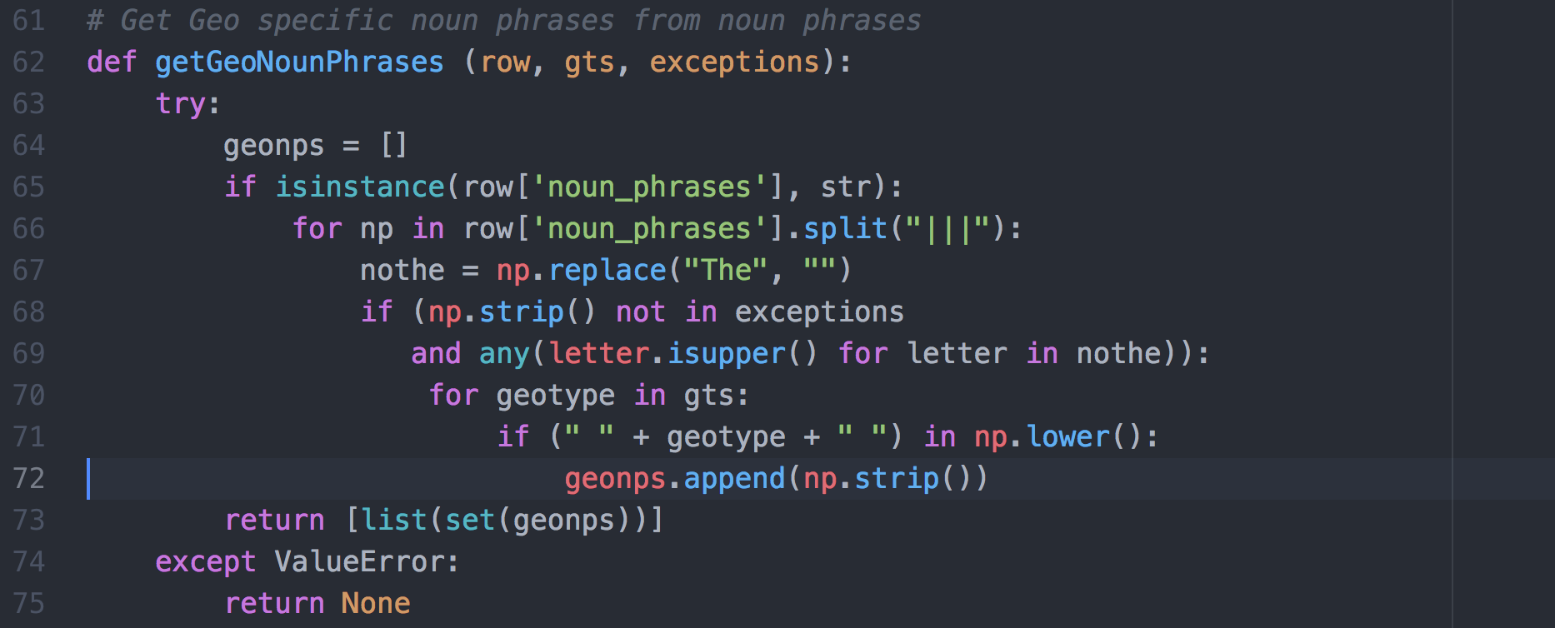
Proper Noun Hack, and in Geo Trigger List

Slide 19
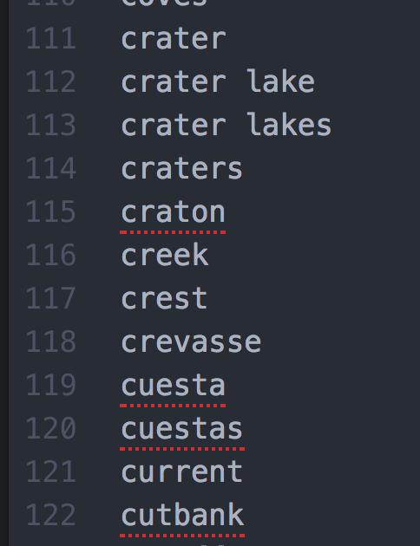
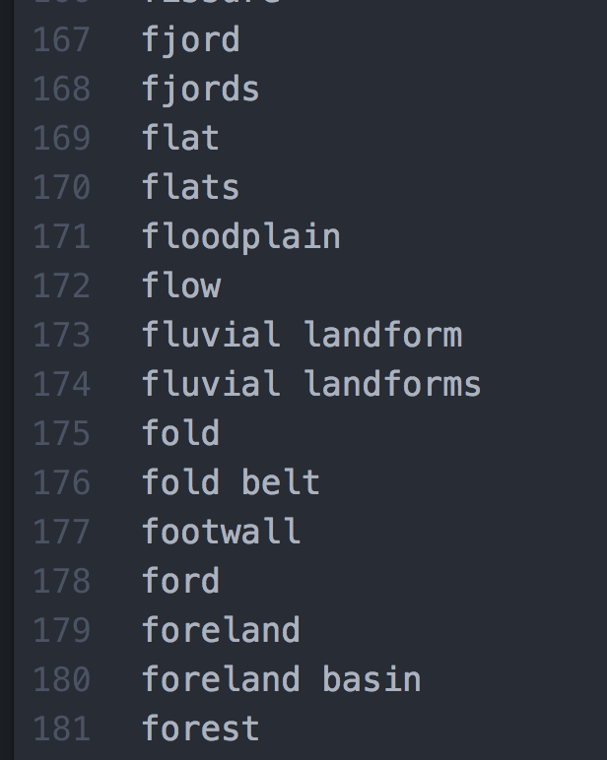
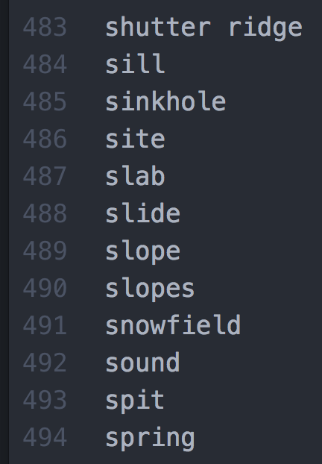
500+ Geological Keywords

Slide 20
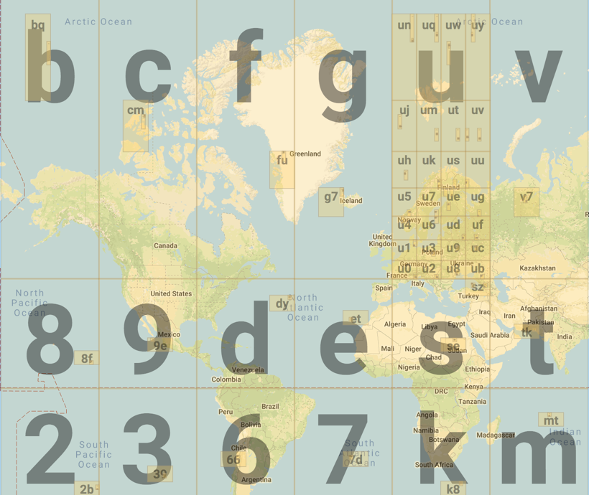
GeoHash
Alphanumeric strings
32 Cell Grids
Represent Lat / Longs
Longer strings == More Precision
Up to 12 characters (≤ 37.2mm × 18.6mm)
Image generated at: http://geohash.gofreerange.com

Slide 21
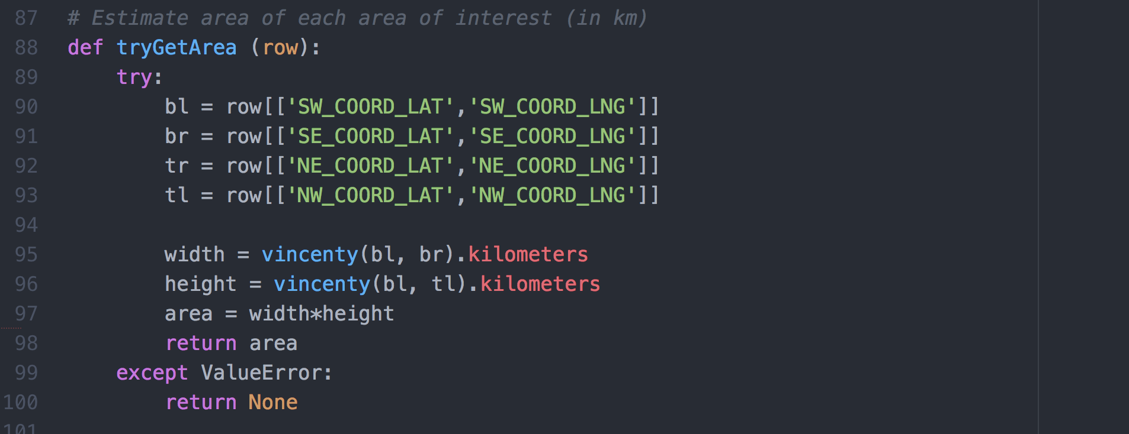
Calculate Approx. Area of Map

Slide 22
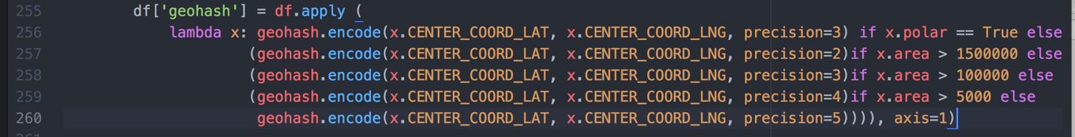
Get Geohash For Center
At a precision appropriate to the Map Area

Slide 23
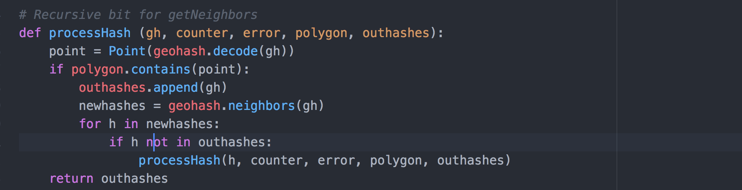
Recursively fill out bounding box

Slide 24
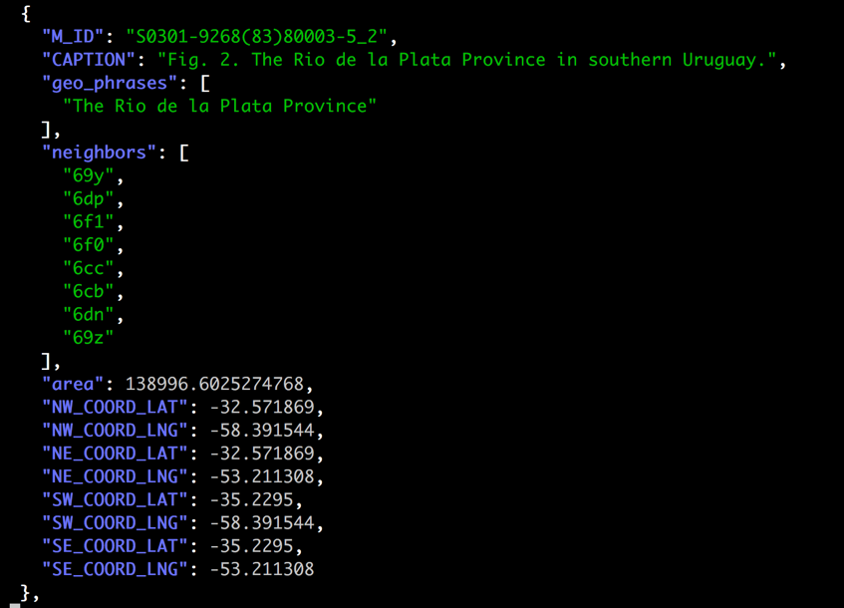
Some rather large regions

Slide 25
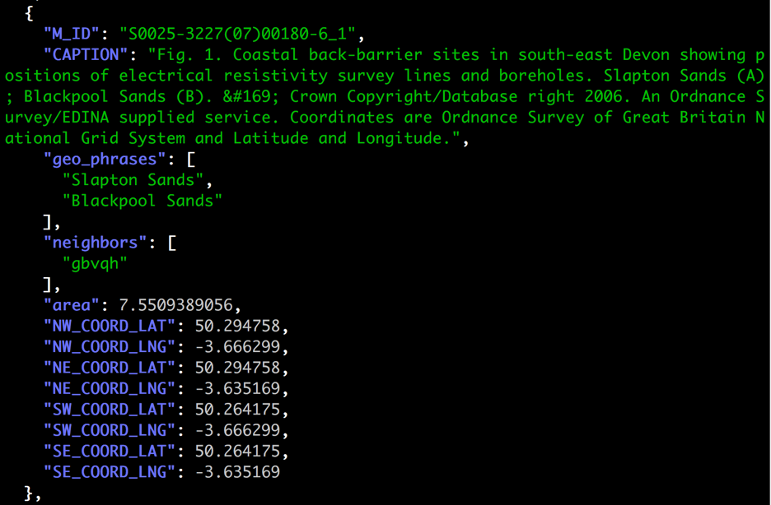
And some very small regions

Slide 26
Elastic Search
Stuff all this JSON in
Map the geo_phrases as keywords
Map the geohashes as geo_points
Get a list of all geohashes
Query every hash, get keyword list and count as aggregations

Slide 27
Reduce and invert
Reformat this data such that:
1 Row per geological named entity
A list of associated hashes / counts: the Little Goose Creek Complex,c2j2=1|c2j2t=1|9rtmk=1|9rtmh=1|9rtmm=1|9rtm=1|9rtmj=1|9rtmt=1|9rtms=1,
Dump to a really simple Django model

Slide 28
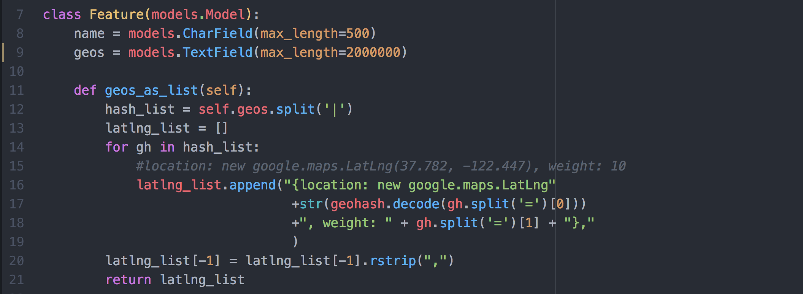
With function to format for Google Maps

Slide 29
Some additional cleanup
Current dataset is still noisy, partly due to:
Noun chunker inconsistencies
Case sensitivity
Presence in initial articles
Stray punctuation symbols
Abbreviations tied to map annotations e.g. SAF-San Andreas fault

Slide 30
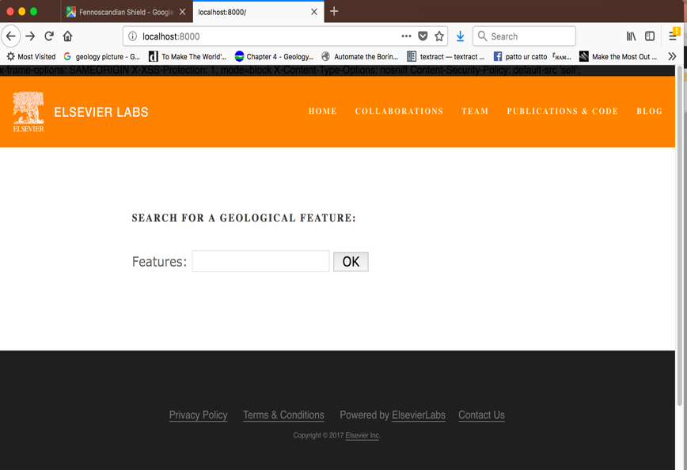
Geocoding Demo

Slide 31
Statistics
In the holdout 20% test data:
About 1/2 of text strings matched a location
About 1/3 of text strings contain a “trigger phrase”
285,453 entries in the current Drupal index
Still a fair amount of noise and duplication
Still likely over 100k unique Geology Entities

Slide 32
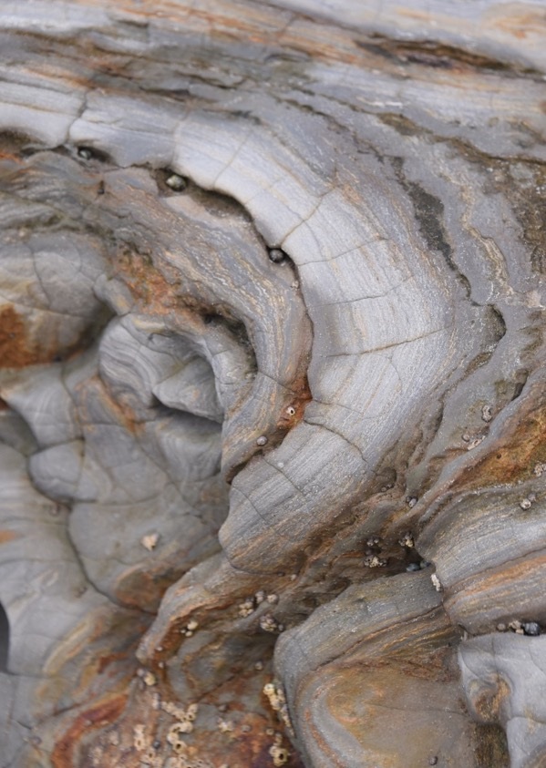
Challenges
Data Cleanup
Noun Chunker
Punctuation & Case
Optimal Geohash precision
Stippled hotspots converted from geohash
Polar Area Maps

Slide 33
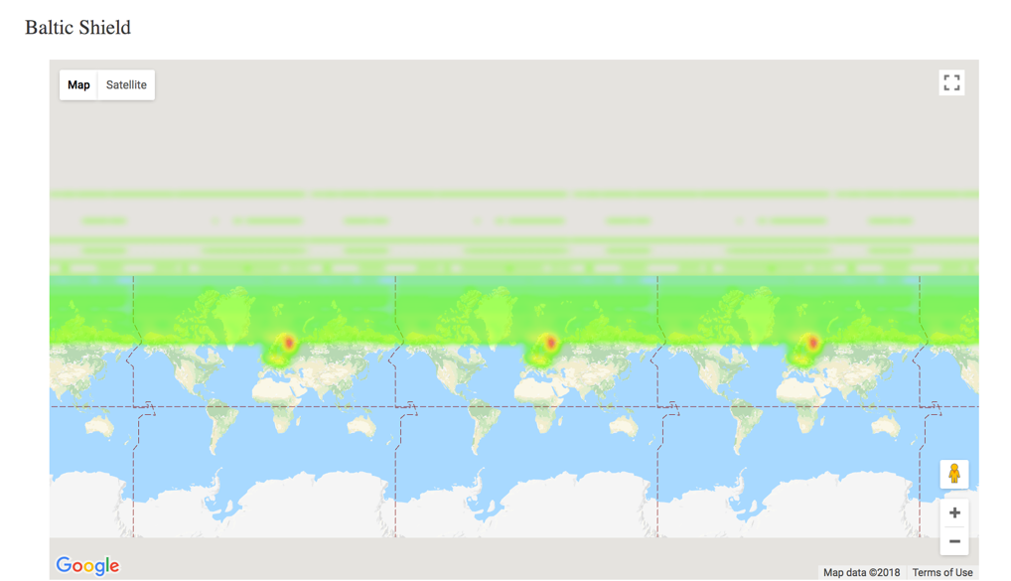
Polar Area Maps

Slide 34
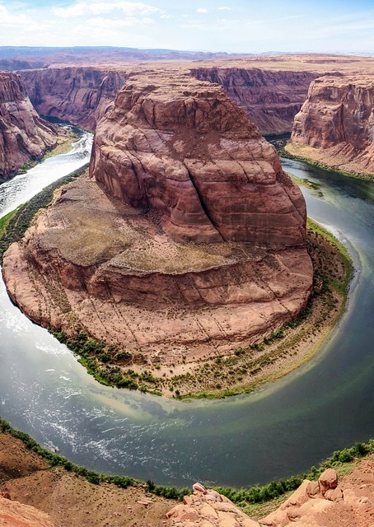
Use Cases
Scaling Geolocation Work
Public Domain Data
3rd Party Data Integration
Non-Cartographic Content
Analogs
Document Analysis

Slide 35
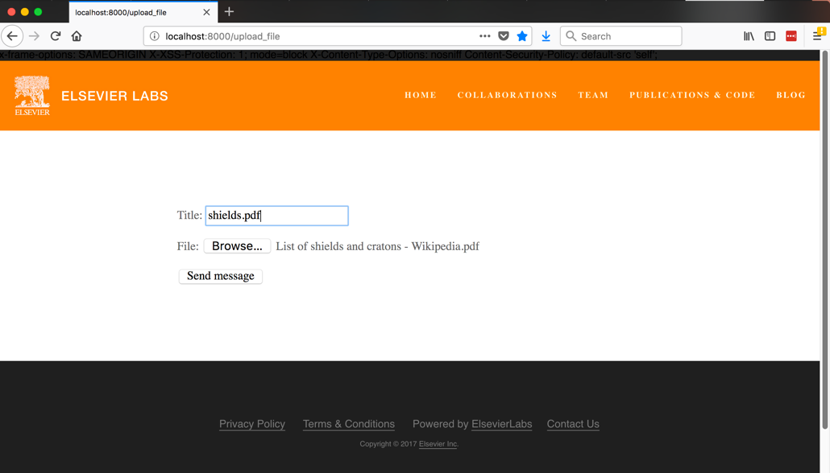
Document Analysis Demo

Slide 36
Conclusion
Geofacets Product
Manual Georeferncing of Map Insets from Geology Articles
Difficult to Scale to New Data Sources
Georeferening, Not Geocoding
How to build a Geolocation Engine for Text Based Geocoding

Slide 37
Please Evaluate the Sessions! Sign in and vote at 2018.foss4g-na.org
Corey A Harper – Elsevier Labs
@chrpr – c.harper@elsevier.com

Slide 38
Geology Images all CC-BY and CC0
https://pixabay.com/en/desert-formation-geology-erosion-2480655/
https://pxhere.com/en/photo/290464
https://commons.wikimedia.org/wiki/File:Granodiorite_of_the_Fennoscandian_Shield.jpg
https://commons.wikimedia.org/wiki/File:A_melhor_coisa_pra_fazer_em_Noronha.jpg
https://www.publicdomainpictures.net/en/view-image.php?image=106887&picture=geology
https://www.maxpixel.net/Geology-Horseshoe-Desert-High-Angle-Shot-1867005

